Slide 1
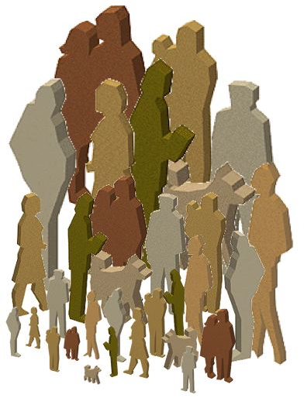

By
Rabia Sarwat

Slide 2

Components of Culture
Non material culture has four components:
Symbol
Language
Values
Norms
These components contribute to both harmony and strife in a society,

Slide 3
Symbols
Definition:
A symbol is anything that meaningfully represents something else.
Culture couldn’t exist without symbols because there would be no shared meanings among people. They help us to communicate ideas such as love, patriotism, emergency etc.
For example flags can stand for patriotism. It was also the source of discord and strife among people. Beginning in the 1990’s and continuing into the 21st century US senate and various state government consider it emotion ridden symbol.
For many others it was a symbol of slavery.

Slide 4
Symbol
Gestures are also symbolic form of communication, a movement of the head, body or hands can express our feelings and ideas.
Symbol affect our thought about class.
Symbol also affect our belief about race and ethnicity. For example black and white are not truly colors but the symbolic meaning associated with these affects everyone.

Slide 5
Language
Definition:
Language is a set of symbols that express ideas and enable people to think and communicate with one another.
There are two types of language:
Verbal Language
Non-Verbal Language
Language help us to share our experiences, feeling and knowledge with others.
Language also enable people to distinguish themselves from outsiders and maintain group boundaries

Slide 6
Language
Language is not solely a human characteristic. Other animals use sound, gestures, touch and smell to communicate with one another but these signals have fixed meanings that are limited to immediate situations and that cannot encompass past and future situation.

Slide 7
Language and Gender
English language ignores women by using the masculine form to refer human being in general. For example “mankind”, “chairman”...
Few words have positive connotation when relating to male or female. For example nurse, secretaries are usually referred as SHE while engineer and electrician are usually referred as HE.
Women are often described by terms such as Doll on the basis of her appearance.

Slide 8
Language, Race and ethnicity
Language reinforced our perception about race and ethnicity by transmitting ideas about superiority of one category of people. For example Native Americans have been referred as primitive and African American have been describes as Pagan.
Few terms such as Nigger, Kike, Chink, Spic and other ethnic slurs have been popularized in movies and music.

Slide 9
Values
DEFINITION:
Values are collective ideas about what is right or wrong, good or bas in a particular culture.
Values do not dictate which behaviors are appropriate or not but they provide us criteria by which we evaluate people, objects and events.
Sociologist identify it ten core values as being important to people in USA.

Slide 10
Values
Individualism
Achievement and Success
Activity and Work
Science and Technology
Progress and Material comfort
Efficiency and Practicality
Equality
Morality
Freedom and Liberty
Racism and Group superiority

Slide 11
Ideal Culture vs. Real Culture
Ideal Culture refers to the values and standards of behavior that people in a society profess to hold.
Real culture refers to values and standards of behaviors that people actually follow.

Slide 12
Norms
Definition:
Norms are established rules of behavior or standards of conduct.
Formal Norms:
Formal Norms are written down and involve specific punishment for violators. Laws are the most common type of formal norm. They have been codified.
Informal norms:
Unwritten standards of behavior understood by people who share common identity. Such as frowning at someone and making a negative comment or gesture.

